Slide 1
Azure Immersion Workshop: IoT
Housekeeping
Notes:
Hi, I’m [name] and I am a [title]
<Transition> Today, I want to dive into our approach with Azure IoT, and help you envision how you can power new possibilities in your own organization and achieve greater business impact.

Slide 2
Some important information to run the workshop
The presenter should turn on the video function during presentation
The presenter should turn off any audio notifications on their laptop
As the attendees are external – someone needs to let them in from the lobby (also during presentations)
We recommend to change their status to “attendee“ status to avoid someone taking over the presentation, etc.

Slide 3
Some important information to run the workshop
We recommend to have at least one proctor to let attendees in from the lobby and – more important – monitor the chat and answer questions there, so that the presenter does not have to do this job in parallel
For the labs we recommend to have two proctors, one to monitor the chat (and to contact and chat with Spectra in case you need support) – and the second to pick up attendees who are not following at the same speed as the others and do the labs with them in a „break-out room“ at Teams in a slower pace

Slide 4
Some important information to run the workshop
Inform the attendees about the key functions of Teams (slides 4-5)
Inform the attendees that the morning presentations will be made available after the workshop
The attendees will also receive a link to a feedback form after the workshop – feedback is highly appreciated
IMPORTANT: Please count the number of attendees and send this number together with a screenshot of the meeting as POE after the event to eva.lehrke@text-event.de and v-chmad@microsoft.com

Slide 5
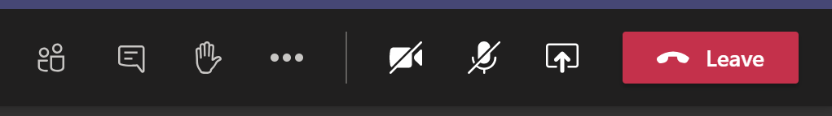
Please inform the attendees about Teams functions
Attendees should mute themselves (otherwise please do it yourself in the “attendee” section)
Please inform in the beginning that they could always use the chat (that has to be monitored by you or your proctors – we recommend to have at least one proctor for chat communication only, so that the presenter does not have to do the job in parallel)…
… or that they could leverage on the ‘Hand’ icon to catch the attention and the presenter will invite to ask the question on the 2-way audio (attendee has to unmute himself for that)

Slide 6
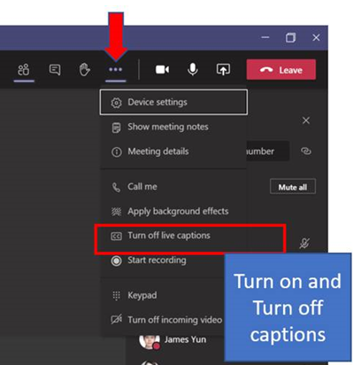
Please inform the attendees about Teams functions
For English subtitles the attendees could use the option to turn on / turn off live captions

